Slide 1

Feature Engineering
Digital Fair - Data

Slide 2


Experience
Data Science and Machine Learning Lead
at PT. Astra Digital Mobil (2024-Now)
Senior Machine Learning Engineer
at Insignia (2023-2024)
Ernest Rudolf Hutapea
Machine Learning Engineer
Mentor
at KepingAI (2020-2023)
AI and Machine Learning
Instructor and Mentor AI ML
at Dibimbing.id (2024 - Now)
LinkedIn:
(Ernest Hutapea)

Slide 3
Outline
Outline
What are features in ML?
What do we do in feature engineering
Steps in feature engineering

Slide 4




What and why?
In machine learning, we try to predict unknown quantity (labels) based on known quantities (features)
Features are individual measurable properties which can be observed during production time
For example, in order to predict house prices, we might use the number of rooms, area, location, as features
Good feature engineering allows ML models to understand and learn from data effectively

Slide 5
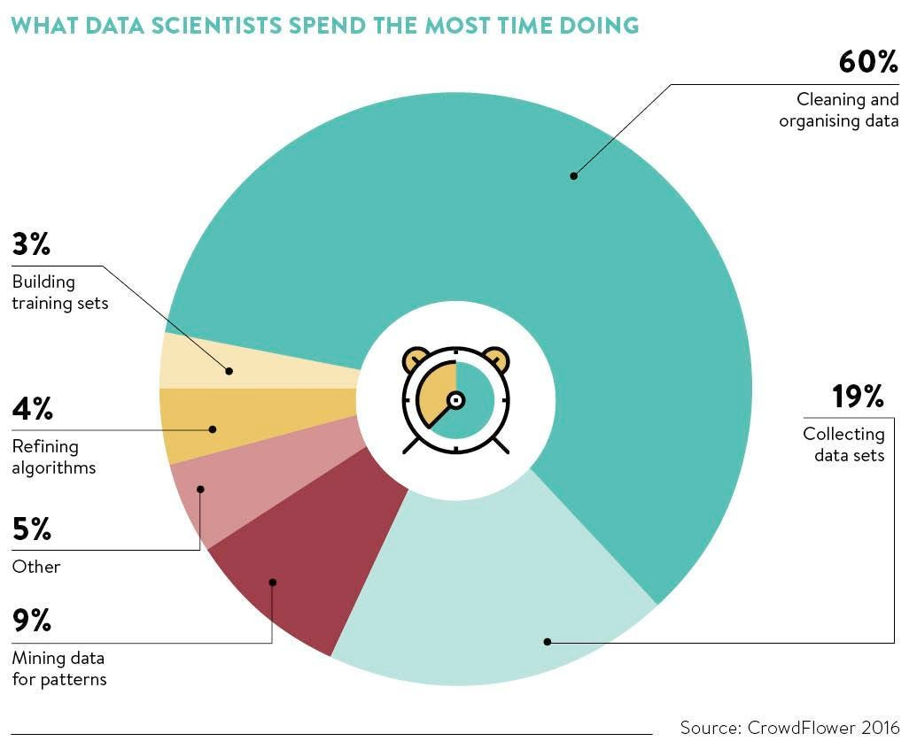
Steps in feature engineering
Collect data from data warehouse and understand the business context
Clean and organize dataset (feature engineering)
Train models / get insights
Evaluate models/insights

Slide 6
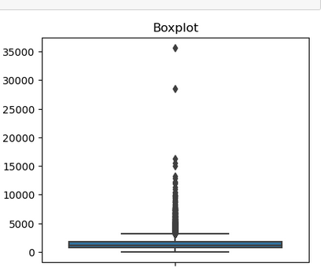




What do we do in feature engineering?
Handle outliers
Handle missing values
Remove duplicates
Handle continuous values
Handle categorical values

Slide 7
Hands on coding
Materials
Collecting and understanding
Handle outliers
Handle missing values
Handle continuous values
Handle missing values
Hands on coding

Slide 8
Thank you

